Slide 1
Lessons Learned from Feedback Received Last Week
Include more people in the task force! Try to get CS researchers with a greater diversity of perspectives.
Do NOT call it an “Evidence Standard.”
A seemingly more agreeable term: “Reporting Standard”
We are a diverse community and won’t agree on the epistemological roots of evidence
Our common ground: Make TOCE papers easier to review, read and search for.
Let’s focus on that common ground today. We’re here to listen
Based on today’s meeting, we will send out a survey to all AEs for further guidance

Slide 2
What goes in a typical Evidence Standard?
Evidence standards vary widely
Some suggest standard section headers and what goes in them (e.g., CONSORT)
Some dictate statistical tests that must be used and acceptable study designs (e.g., WWC)
Some are checklists for various kinds of studies (e.g., COREQ)
Some are open to the public (WWC, CONSORT) and others must be purchased (APA)
Some are vague and others are hyper-specific
Audience Question 1: How should authors report a T-test?

Slide 3
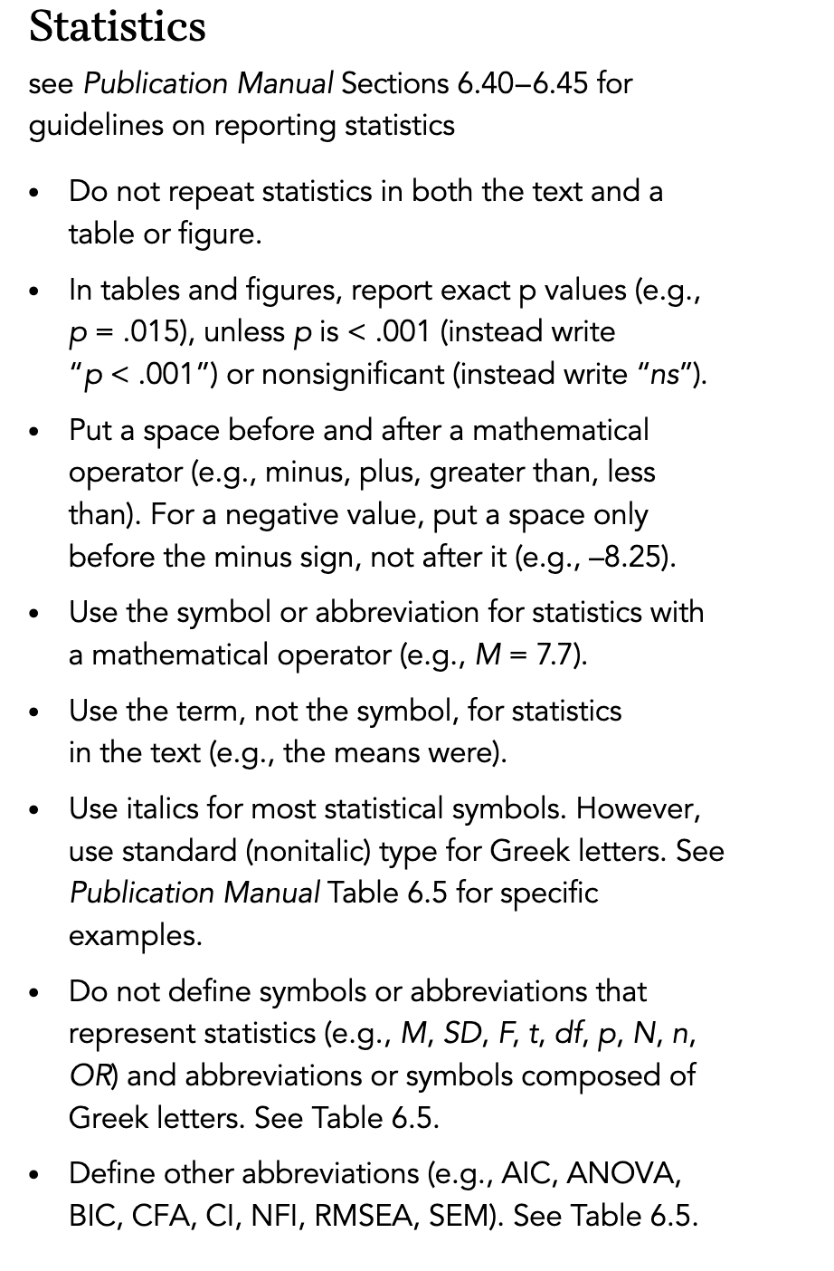
APA's answer to the question
APA
There was no significant effect for thing, t(38) = 1.7, p = .097, despite A (M = 55, SD = 8) being higher than B (M = 53, SD = 7.8).
Observations
APA requires degrees of freedom, t-value, p-value, and means and standard deviations
Reporting an effect size is typical and encouraged
The APA manuals describe how to report this in relatively plain English
The cost of the manual for how to do this is about $45.

Slide 4
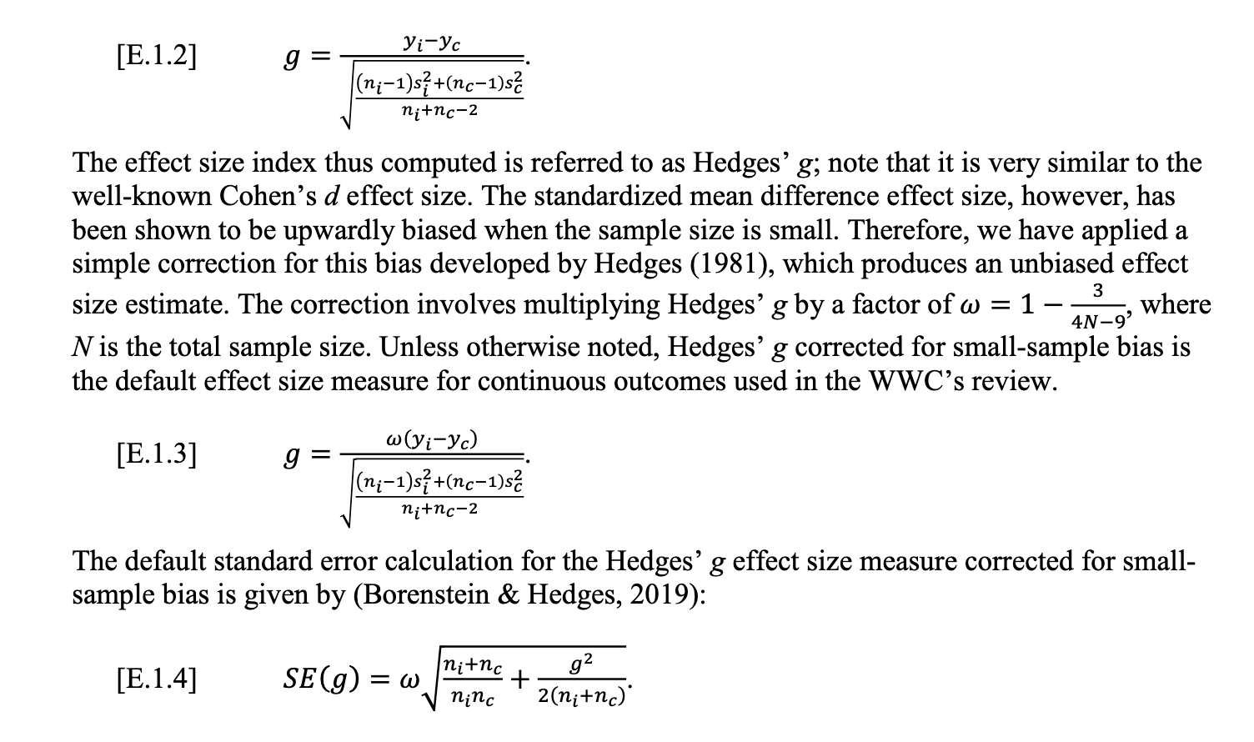
What Works Clearinghouse's Answer
Observations
No specific reporting needed for how to specify t-values
Effect size is required
Description is written in very mathematical language
English Translation: WWC wants authors to use Hedge's g and not Cohen's d.

Slide 5
Audience Question 2
In a qualitative study, what aspects of a study design should be reported by authors?

Slide 6
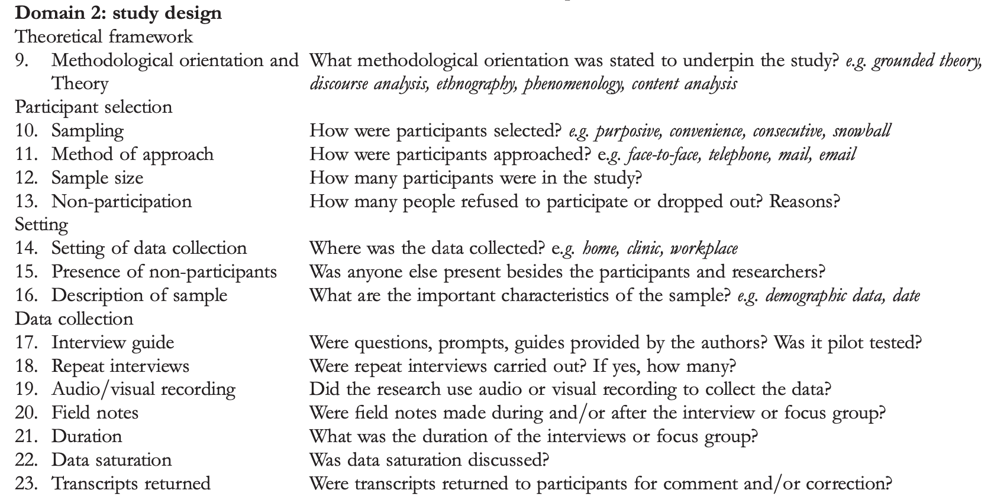
COREQ's partial answer to the question
COREQ (COnsolidated criteria for REporting Qualitative research) Checklist consists of 32 items: https://www.elsevier.com/__data/promis_misc/ISSM_COREQ_Checklist.pdf

Slide 7
Audience Question 3:
In a discussion section, what should authors report?

Slide 8
CONSORT's Answer to the question
Observations:
CONSORT uses the word trial everywhere. This is because medical experts have a very broad definition of what a trial is. It may have a meaning different than what you are used to
Discussing the limitations, generalisability, and interpretation is common in TOCE

Slide 9
Structured Abstracts have been carefully studied
The medical community introduced the idea in the mid 1980s
In 2004 Hartley reviewed 31 studies that evaluated the impact
Overall findings show they
Contain more information (11 studies, 1 negative)
Are easier to read (3 studies)
Are easier to search (2 studies for, 3 against)
Facilitate peer review (3 studies) --- think things like reviewer bidding
Are generally welcomed by readers and authors (6 studies)
But that they
Take more space (10 studies)
Can have confusing typographic layouts (2 studies)
May be prone to omissions, just like traditional abstracts (8 studies)
The same author updated his findings in 2014 (similar conclusions)
Hartley J. Current findings from research on structured abstracts. J Med Libr Assoc. 2004;92(3):368-371.

